Slide 1
Tracking Omnichannel Performance:
From First to Last Touch
December, 2017
Romanoff Consultants • 524 Broadway 11th Floor, New York, NY 10012 • (212) 390-0400 • www.romanoffconsultants.com

Slide 2
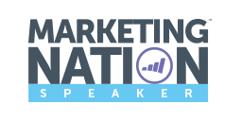
INGA ROMANOFF
Global MarTech Expert | Thought Leader
Skills
MARKETING AUTOMATION
Biography
92%
Inga is a thought leader, international speaker, and a strategic global marketing Professional with 20+ years of success in driving growth in B2B and B2C environment.
Inga's leadership in the industry is recognized by her elite status as a 5x Marketo Champion and a Revvie Award for most Dramatic Business Impact. In 2017, Inga was awarded Woman of the Year by International Stevie Awards and named Top Female MarTech Influencer by Onalytica and TopRank Marketing.
Inga serves as a Marketo User Group leader in New York since 2012.
ADVANCED DATA SKILLS
80%
INDUSTRY TRENDS
90%
Inga Romanoff
GLOBAL MARKETER
Chief Executive Officer
Romanoff Consultants
70%
SALES LEADERSHIP EXPERIENCE
70%

Slide 3
AGENDA
First Touch, Last Touch, or Something Else?
Philosophy of Conversions
Omnichannel Tracking
Why Track and Takeaways

Slide 4
Attribution is the science of assigning credit or allocating dollars from a sale to the marketing touchpoints that a customer was exposed to prior to their purchase.
Notes:
Despite all the modern tools available to marketers, the marketing attribution problem still exists. Perhaps, even more now - as our digital environment became more sophisticated, the systems are still not capturing attribution data.
Interestingly, availability of marketing analytics data made marketers comfortable with looking at detailed data about particular touchpoints like the clicks a display ad gets, and tweaking things to improve but not necessarily understanding if those clicks lead to business Closed Won. What was lacking was the broad view of what was working and what wasn’t, which advanced attribution provides. Decisions can now be made based on what users are responding to, and these decisions can have a dramatic impact on results.

Slide 5
Philosophy of Conversions
Opportunity
Created
1
2
3
Conversion 1
Becomes visitor
(Marketo cookie is created)
e.g. ad performance, # conversions
Conversion 2
Opts In: Becomes Marketo Lead
(gives at least an email)
e.g. # of form fills on site, # of leads
Conversion 3
Becomes Customer
(Opportunity Closed Won, eCommerce, or purchase with Sales)
e.g. total number of deals and amount of sales

Slide 6
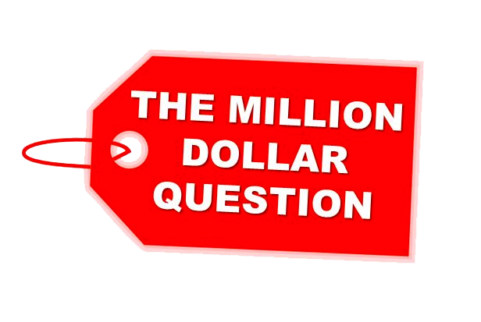
First Touch, Last Touch, Or Something Else?
Only about 22% of businesses are satisfied with their conversion rates¹ and 80% of marketers report their lead generation efforts are only slightly or somewhat effective²
No shortage of options, but mostly defined by what channels are chosen to invest in
The truth is, most of them don’t have full visibility of their acquisition efforts performance
Three basic models of marketing attribution:
First Touch
Last Touch
Multi-Touch
¹ Econsultancy, 2016
² BrightTALK, 2015
Notes:
What is attribution?
Attribution is how Marketo gives credit to the programs that help influence sales and opportunities. If you use the Marketo revenue modeler, attribution can also give credit for moving someone forward in your business model.
Only about 22% of businesses are satisfied with their conversion rates¹ and 80% of marketers report their lead generation efforts are only slightly or somewhat effective²
No shortage of options, Marketing efforts are largely defined by the channels they choose (and don’t choose) to invest in. Due to budget constraints, the choice often comes down to one channel over another.
The truth is, most of them don’t have full visibility of their acquisition efforts performance
To truly optimize any particular company’s conversion channels, a proper comparison is required. That’s where the marketing attribution model comes in. Marketing attribution allows you to tie conversions and revenue to the channels that were involved. This provides hard numbers to inform your decisions and justify your reasoning.
Three basic models of marketing attribution:
First Touch
Last Touch
Multi-Touch

Slide 7
Interaction Touchpoints
First Touch (FT) Attribution
Visitor
Lead Capture
Opportunity Created
The credit is assigned to the first marketing touchpoint. More specifically, 100% of the deal value is assigned to the channel and/or activity that acquired the contact.
Last Touch (LT) Attribution
Visitor
Lead Capture
Opportunity Created
Last touch attribution is the opposite end, where 100% of the value is assigned to the final touchpoint before the opportunity was created.
Multi-Touch Attribution
Multi-touch attribution is any model that assigns some share of the credit to more than one touchpoint.
Notes:
So, Which Attribution Model is the Best?
The better question is, which attribution model is best for my company. No approach is the best in all circumstances. Multi-touch attribution has the power to be the most accurate, but relies accurate data points collection. Unless your company has a particularly complicated marketing mix, or a very long buying cycle, a single touchpoint attribution can be just as effective.
First-Touch (FT) Attribution
First-Touch (FT) attribution answers a question, "Which programs are good at acquiring profitable new names?"
Last-Touch (LT) Attribution
Last-Touch (LT) attribution answers a question, "Which programs are good at converting leads to deals?"
Multi-Touch Attribution
Multi-Touch answers a complicated business question, "Which programs are most influential in moving people forward in the sales cycle over time?”
A Forrester study commissioned by Google found that simplistic attribution (first- or last-touch) reigns supreme, with 40% of enterprise firms still utilizing those models to measure their digital marketing performance. A good starting point is to choose either first touch or last touch, depending on whether you’re stronger at driving leads that look like your sweet spot customer (FT) or are ready to buy (LT). From there, if you’re unsatisfied with the attribution of the single touchpoint model, use it as a basis to upgrade to multi-touch.
Forrester Study: https://think.storage.googleapis.com/docs/forrester-cross-channel-attribution_research-studies.pdf

Slide 8
First Touch (FT) Attribution
Visitor
Lead Capture
Opportunity Created
Pros: You can learn which channels are attracting potential customers and which channels are the most successful.
For example, if your $1,000 a month Facebook ad campaign is sending a ton of traffic to your site, that might indicate that you should experiment with increasing that budget and seeing if you can also increase results.
Cons: First touch gives you information about channels but doesn’t tell the whole story. Sure, that Facebook ad is sending you a lot of traffic, but how much of it actually converts to a purchase?

Slide 9
Last Touch (LT) Attribution
Visitor
Lead Capture
Opportunity Created
Pros: This is the final nudge that pushed the lead over the edge and into becoming a customer.
Cons: Relying solely on last touch, in a way, ignores all the efforts that led to that final touchpoint. So giving all the credit to that last touch may skew the view of your buyer journey.
Last touch attribution tends to be more conservative. Marketers can calculate the spend within that channel and the conversion received. But completely wiping out the time and money spent on branding in between first and last touch makes this a false computation. No one just wakes up and buys something it’s a series of touchbpoints with the brand.

Slide 10
Multi-Touch Attribution
Visitor
Lead Capture
Opportunity Created
1X
1X
1X
1X
1X
1X
X=total number of touchpoints
The way it works is by assigning value to each touchpoint, you get a better sense of how that marketing effort is working in-between first touch and last touch.
It can also be valuable to look at results from first and last touch together. For example (using the same Facebook ad example), if your first touch analytics tell you that a ton of traffic is coming to your website from a Facebook ad, then look at conversion and see how well your last touch attribution is faring from that particular channel. You may see that lots of people are visiting your site but not actually converting, which could tell you that the ad might not be tightly written enough to send the right people — the ones that would buy from you — to your site.
Notes:
But to really get the 360 view of your consumer, you need to understand all consumer touch points, from the first to the ones in the middle to the last.

Slide 11
“Half the money I spend on advertising is wasted; the trouble is I don’t know which half.”
- John Wanamaker, early 1900s

Slide 12
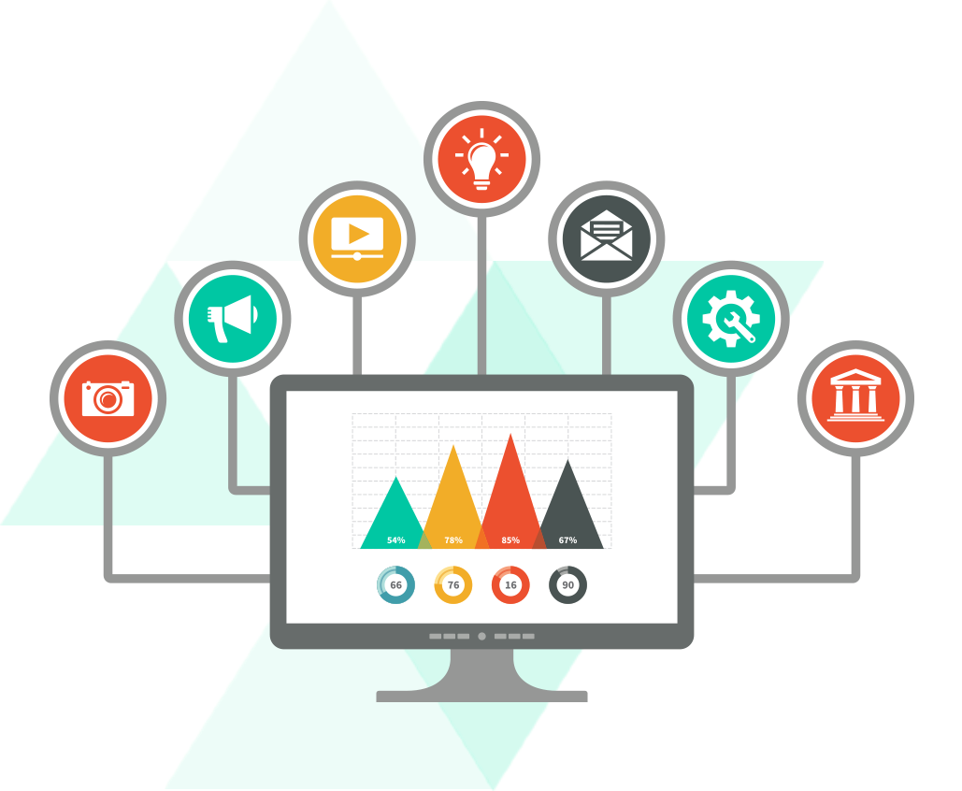
Attribution vs. Advanced Analytics
Attribution allows to uncover what touchpoints are producing results, e.g. people visiting a certain landing page are more likely to buy your product
Advanced Analytics drills down further into understanding of a particular touchpoint, what is causing people to respond to, i.e. determining common traits about those visiting the page, to make it even more appealing
Notes:
By the way, advanced analytics was available long before advanced attribution was

Slide 13
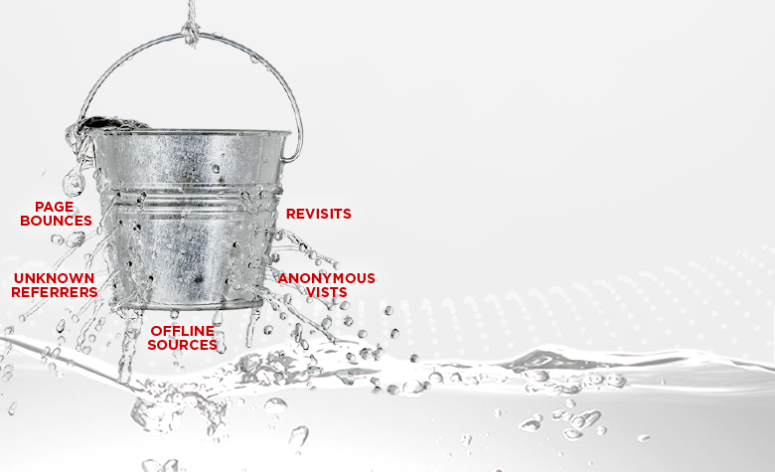
Advanced Attribution
89% of marketers believe is important but 34% attempt a multi-touch attribution model
Most Marketo implementations have a leaky bucket when measuring website traffic and ads
Some offline channels may appear as “list import”
One channel may be better at closing a sale and another at assisting the sale. Advanced Attribution allows to attribute the sale to all the channels and campaigns that contributed
Notes:
In advanced attribution modeling, the credit for conversion is assigned proportionally to each touchpoint according to its influence on the customer’s purchase or conversion decision. The goal of attribution is to determine which touchpoints are producing a positive result, and, by using the cost of each touchpoint, an advanced attribution system can then show which touchpoints are profitable. This allows constant optimization of marketing dollars.

Slide 14
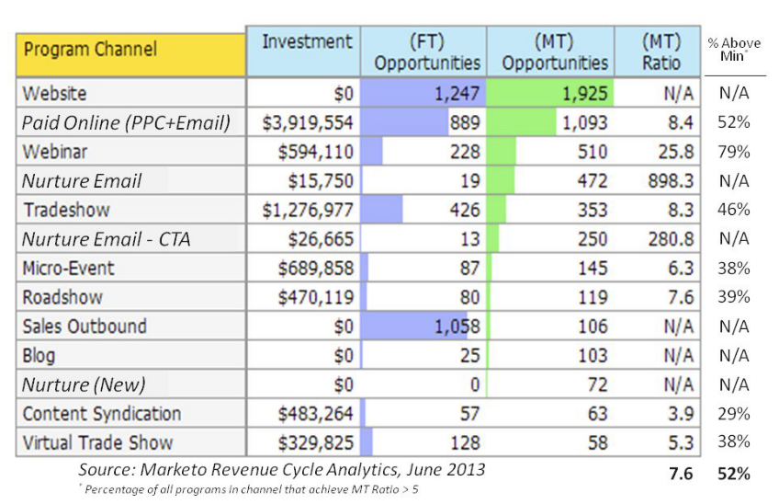
Some Tracking in Marketo
Marketo allows for source and campaign influence tracking
Program Analyzer
Channel Effectiveness
Program Analyzer
Some limitations:
Data coverage
Requires period costs
Notes:
Marketo allows for FT and MT attribution tracking (source and campaign influence)
Program Analyzer and success statuses for marketing programs track which programs and channels have the biggest impact
Some limitations:
Data coverage
Requires period costs

Slide 16
Omnichannel Tracking
Consumers today see no boundaries (online, on device, out of home, in-store) and expect marketers to reach them where they are with a consistent message
Number of data sources continues to grow
Consider questions:
Do my offline channels get proper attribution?
Should I redistribution more budgets to more profitable channels and campaigns?
What’s the media mix that will drive the most value for the business as a whole - ultimately providing the best customer experience (online and offline)?
These complex questions cannot be answered by any single channel
Tracking / Analytics tools: Bizible, FunnelWise, ConversionPath, BrightFunnel, CAKE, Full Circle Insights, and many others
Notes:
What is attribution?
Attribution is how Marketo gives credit to the programs that help influence sales and opportunities. If you use the Marketo modeler, attribution can also give credit for moving someone forward in your business model.
Only about 22% of businesses are satisfied with their conversion rates¹ and 80% of marketers report their lead generation efforts are only slightly or somewhat effective²
No shortage of options, Marketing efforts are largely defined by the channels they choose (and don’t choose) to invest in. Due to budget constraints, the choice often comes down to one channel over another.
The truth is, most of them don’t have full visibility of their acquisition efforts performance
To truly optimize any particular company’s conversion channels, a proper comparison is required. That’s where the marketing attribution model comes in. Marketing attribution allows you to tie conversions and revenue to the channels that were involved. This provides hard numbers to inform your decisions and justify your reasoning.
Three basic schools of marketing attribution:
First Touch Attribution
Last Touch Attribution
Multi-Touch Attribution

Slide 17
Takeaways: Attribution Drives Marketing Impact
Modern technology could automate 45% of the activities people are paid to perform, and about 60% of all occupations could see 30% or more of their activities automated¹
Accurate attribution methodology allows marketers to work smarter, not harder, it illuminates opportunities for improving strategy and measure return on their efforts
Consumers use more channels than ever to connect with brands
Marketing Technology Stack continues to drive additional layers of complexity
Companies demand higher accountability for marketing dollars spent and see Chief Marketing Officer (CMO) as their Growth Officer
Attribution provides sophisticated view of the customer journey
¹ McKinsey Research, 2016

Slide 18
18
INGA ROMANOFF/ TEXT YOUR EMAIL TO (415) 212-5051 FOR FOLLOW UP
NEW YORK HQ
Romanoff Consultants
524 Broadway, Floor 11
New York, NY 10012
THANK YOU
Office: (212) 390-0400
contact@rc.solutions
@ingaroma
www.linkedin.com/in/ingaromanoff

Slide 19
Attribution Example 1
Read the following scenario and try to determine the numbers that should be in the grid.
April 11 | Fred is acquired by (Tradeshow)
April 15 | Margo attends (Webinar) - success
April 22 | Fred is associated (role) to the opportunity
April 22 | Opportunity is created for $3,000
Program Name | (Tradeshow) | (Webinar)
(FT) Oppty Created
(FT) Pipeline Created
(FT) Oppty Won
(FT) Revenue Won

Slide 20
Attribution Example 1
April 11 | Fred is acquired by (Tradeshow)
April 15 | Margo attends (Webinar) - success
April 22 | Fred is associated (role) to the opportunity
April 22 | Opportunity is created for $3,000
Answers
Program Name | (Tradeshow) | (Webinar)
(FT) Oppty Created | 1 | -
(FT) Pipeline Created | $3,000 | -
(FT) Oppty Won | - | -
(FT) Revenue Won | - | -
The reason the Tradeshow received all credit is because Margo was not associated with a role in the opportunity. No role, no credit.

Slide 21
Attribution Example 2
Read the following scenario and try to determine the numbers that should be in the grid.
April 11 | Bill is acquired by (Tradeshow)
April 15 | Joan is acquired by (Webinar)
April 22 | (Opportunity 1) created for $6,000
April 24 | (Opportunity 2) created for $10,000
April 25 | Bill and Joan are associated with roles to BOTH Opptys
April 29 | (Opportunity 1) is Closed-Won
Program Name | (Tradeshow) | (Webinar)
(FT) Oppty Created
(FT) Pipeline Created
(FT) Oppty Won
(FT) Revenue Won

Slide 22
Attribution Example 2
April 11 | Bill is acquired by (Tradeshow)
April 15 | Joan is acquired by (Webinar)
April 22 | (Opportunity 1) created for $6,000
April 24 | (Opportunity 2) created for $10,000
April 25 | Bill and Joan are associated with roles to BOTH Opptys
April 29 | (Opportunity 1) is Closed-Won
Answers
Program Name | (Tradeshow) | (Webinar)
(FT) Oppty Created | 1 | 1
(FT) Pipeline Created | $8,000 | $8,000
(FT) Oppty Won | 0.5 | 0.5
(FT) Revenue Won | $3,000 | $3,000
Because both Bill and Joan were associated with roles to BOTH opportunities, the system (according to the rules) split the credit evenly between them.
Pipeline created for each program ($8,000) is half of the total ($16,000) available to give as credit.

Slide 23
Attribution Example 3
Read the following scenario and try to determine the numbers that should be in the grid.
April 11 | Steve downloads (Content) - success
April 22 | Opportunity is created for $3,000 (Both Steve and Jason have roles)
April 25 | Jason attends (Webinar) - success
April 30 | Opportunity is Closed-Won
Program Name | (Tradeshow) | (Webinar)
(MT) Oppty Created
(MT) Pipeline Created
(MT) Oppty Won
(MT) Revenue Won

Slide 24
Attribution Example 3
April 11 | Steve downloads (Content) - success
April 22 | Opportunity is created for $3,000 (Both Steve and Jason have roles)
April 25 | Jason attends (Webinar) - success
April 30 | Opportunity is Closed-Won
Answers
Program Name | (Content) | (Webinar)
(MT) Oppty Created | 1 | -
(MT) Pipeline Created | $3,000 | -
(MT) Oppty Won | 0.5 | 0.5
(MT) Revenue Won | $1,500 | $1,500
Jason had program success AFTER the oppty was created. Therefore, the webinar can't get credit for the creation of the opportunity. Only credit for the Opty won.
Therefore, (Content) has 100% of credit for the Oppty creation and pipeline, but only 50% credit for the opty won.

Slide 25
Attribution Example 4
Read the following scenario and try to determine the numbers that should be in the grid.
April 11 | Michelle downloads e-Book (Content) - success
April 15 | John attends (Webinar) - success
April 22 | (Opportunity 1) created for $3,000
April 24 | (Opportunity 2) created for $5,000
April 25 | John and Michelle are associated to both Opptys
April 29 | [Oppty 1] is Closed-Won
Program Name | (Tradeshow) |  | (Webinar)
 | (Oppty 1) | (Oppty 2) | (Oppty 1) | (Oppty 2)
(MT) Oppty Created
(MT) Pipeline Created
(MT) Oppty Won
(MT) Revenue Won

Slide 26
Attribution Example 4
April 11 | Michelle downloads e-Book (Content) - success
April 15 | John attends (Webinar) - success
April 22 | (Opportunity 1) created for $3,000
April 24 | (Opportunity 2) created for $5,000
April 25 | John and Michelle are associated to both Opptys
April 29 | [Oppty 1] is Closed-Won
Answers
Program Name | (Tradeshow) |  | (Webinar)
 | (Oppty 1) | (Oppty 2) | (Oppty 1) | (Oppty 2)
(FT) Oppty Created | 0.5 | 0.5 | 0.5 | 0.5
(FT) Pipeline Created | $1,500 | $2,500 | $1,500 | $2,500
(FT) Oppty Won | 0.5 | - | 0.5 | -
(FT) Revenue Won | $1,500 | - | $1,500 | -
When you have multiple opportunities and multiple people with program success, you have to split the credit between the people and programs. However, notice that the credit for opportunity 1 and 2 are not combined. Each is a distinct credit evaluation.
When many people are involved, Marketo will automatically calculate the fractions of an opportunity to give credit for.

